Slide 1
Does Education & Experience Impact Developer Compensation?
Data Analysis Dr Mohamed Taher
Omar Mahmoud Elamir Elsady Ahmed Motaz

Slide 2
INTRODUCTION
01
Does the education level and years of experience impact the income of developers?

Slide 3
In today's rapidly evolving tech landscape, understanding the factors that influence developer compensation is crucial for both employers and professionals.
Data Analysis : Using meticulously gathered data, we analyze various parameters such as experience, education level, employment status, industry type, age, and yearly salary.
Purpose : This study investigates the significant impact of education level and professional coding experience on developers' yearly compensation.
Hypothesis : The level of education and years of professional coding experience significantly impacts the yearly compensation of developers.
Research Question : Does the education level and years of experience impact the income of developers?

Slide 4
METHODOLOGY & BIAS CONSIDERATIONS
02

Slide 5
Population of Interest:
.The population comprises developers from various industries, with differing levels of education and professional experience .Includes developers working full-time, part-time, and self-employed, spanning a range of ages and industries. .Dataset aims to cover the whole population of developers in general.

Slide 6
Sampling Method:
. Data sourced from the 2023 Stack Overflow Developer Survey, conducted from May 8 to May 19, 2023 .Respondents primarily recruited through Stack Overflow channels: onsite messaging, blog posts, email lists, meta.stackoverflow posts, banner ads, and social media.Considered convenience sampling, potentially skewing towards highly engaged users on Stack Overflow .Provides a large and diverse dataset but may contain biases due to the sampling method.

Slide 7
Bias Identification:
Consideration of potential biases, including self-reporting and sampling biases .Anonymity ensured, and honest responses encouraged .Data segmented by categories like employment type and industry for meaningful comparisons .Allows for avoiding salary comparisons between groups with inherently different earning potentials, such as full-time and self-employed individuals.

Slide 8
DATASET
03

Slide 9
Source : Derived from the 2023 Stack Overflow Developer Survey.
Cleaning Process: Original dataset: 89,185 entries After cleaning (removing null values): 6,351 entries.
Important Columns:
EdLevel : -Records highest level of education: primary school to PhD -Essential for assessing its influence on professional coding experience and compensation.
YearsCodePro : -Captures years of professional coding experience -Provides insight into how experience affects yearly compensation.
Industry : -Specifies industry of employment -Industry standards often vary, impacting compensation.
ConvertedCompYearly : - Represents yearly compensation converted to USD -Primary metric for analyzing education, experience, and employment type impact on earnings.

Slide 10
ANALYSIS
04

Slide 11
Before analyzing our dataset, we conducted thorough cleaning to ensure
accuracy. -We removed records with null values and those that didn't fit expected
ranges, - eliminating potential biases. -We then mapped similar answers to key elements, -streamlining the dataset. -To ensure fairness and reduce skewness, we
split certain categories, like employment and industry types, to avoid comparing individuals with inherently different earning possibilities. This preprocessing provided a cleaner, more consistent dataset for reliable analysis.

Slide 12
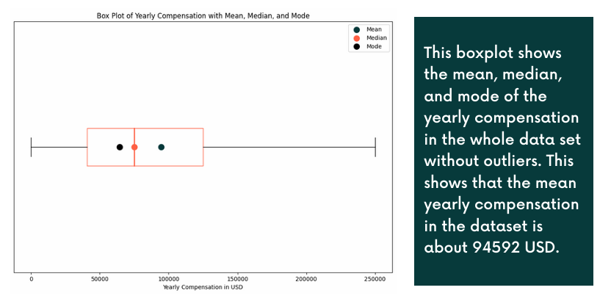

Slide 13
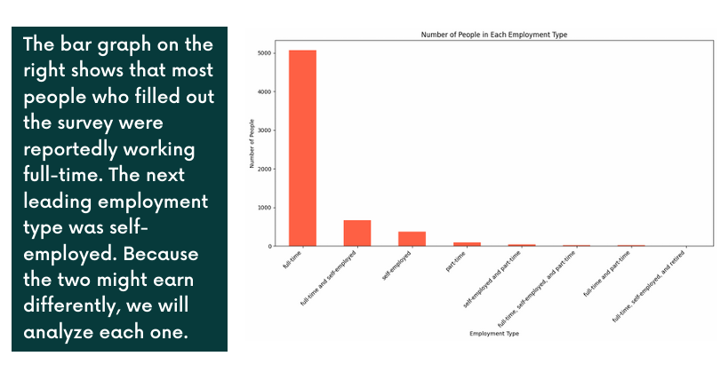

Slide 14
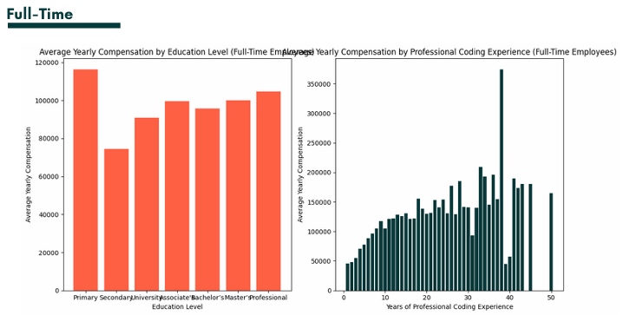
Analysis of full-time employees shows a gradual increase in compensation with higher education levels, starting from secondary school. However, a clearer correlation is observed between compensation and years of professional coding experience, with compensation increasing as experience grows.

Slide 15
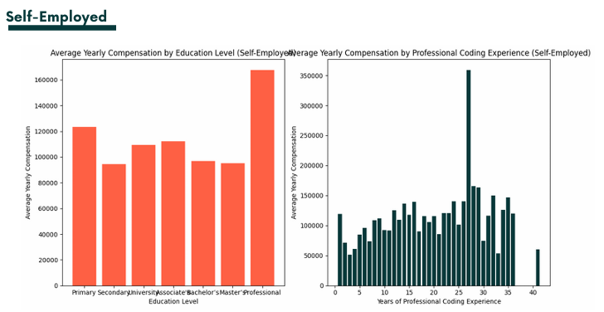
For self-employed individuals, there is no clear correlation between education and compensation. Similarly, the graph for years of professional coding experience does not show a clear correlation with compensation, except for the range of 2-15 years, where compensation tends to increase with more years of professional coding experience.

Slide 16
-Additionally to splitting an analyzing the data set by full-time and self-employed
individuals, different industries may also significantly different compensation, so we analyze the top three industries in the data set.
- For the top three industries (IT, Healthcare, and Finance), we plot education level and years of professional coding against compensation. Throughout all three industries, we cannot see a clear correlation between education level and compensation when looking at the graphs. However, when looking at the graphs for years of professional programming vs compensation, it is clear that there is a slight correlation between the two for all industries, and as one gains more years of professional programming experience, their compensation tends to increase.

Slide 17
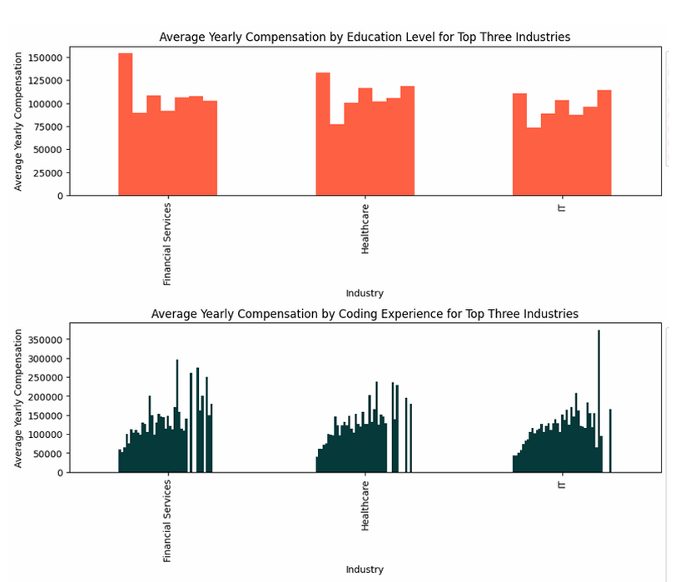

Slide 18
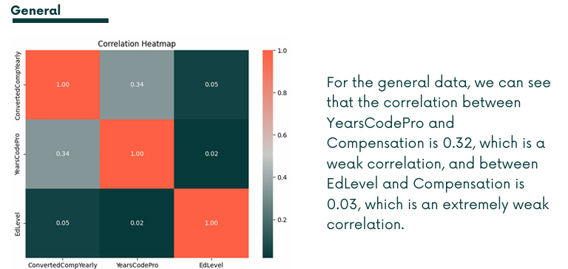

Slide 19
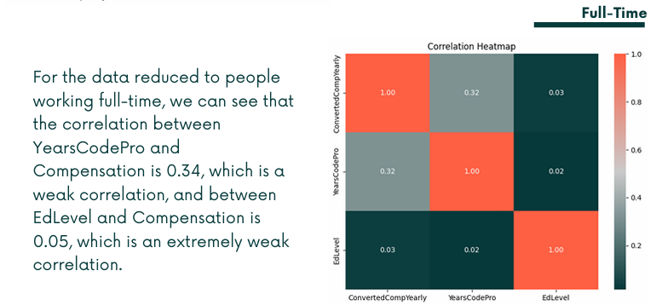

Slide 21
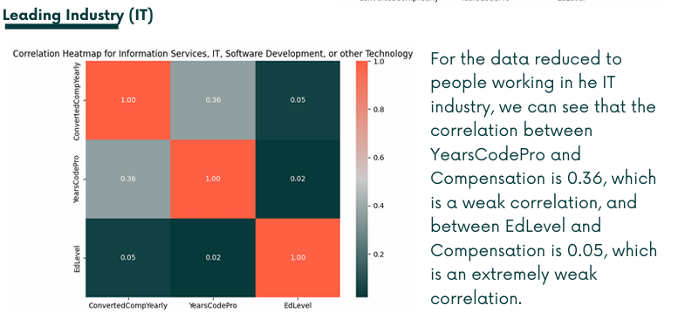

Slide 22
FURTHERE FINDINGS
05

Slide 23
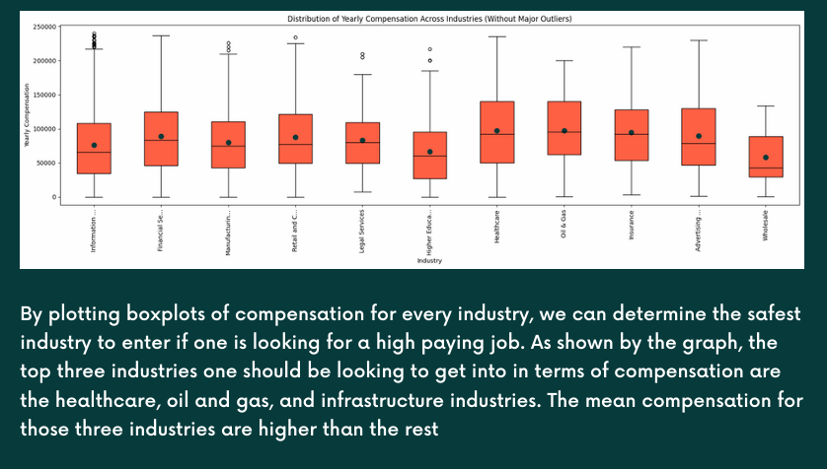

Slide 24
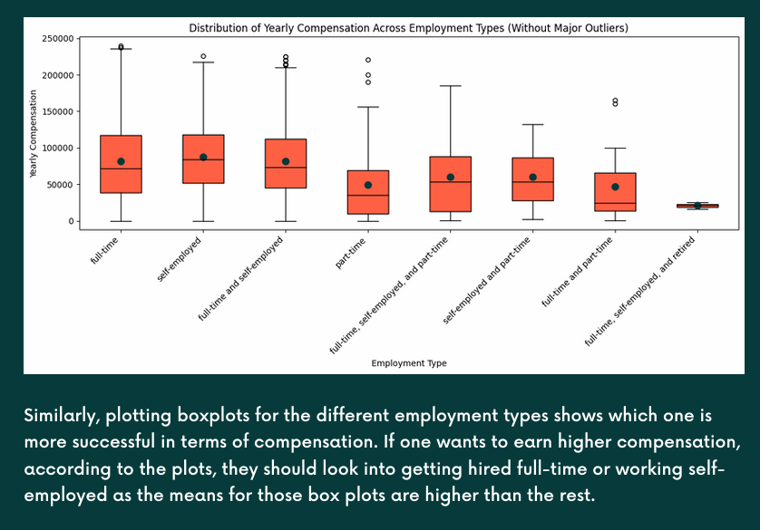

Slide 25
HYPOTHESIS TESTING
06

Slide 26
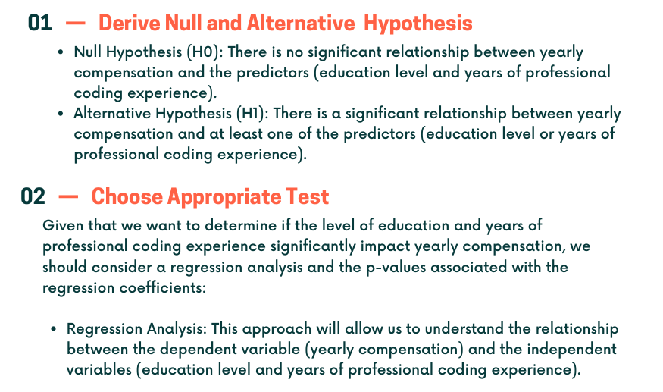

Slide 27
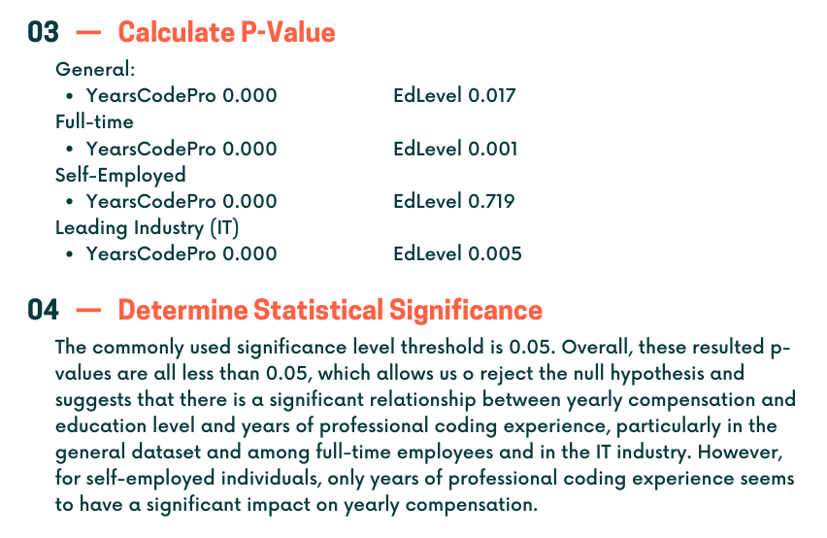

Slide 28
CONCLUSION
07

Slide 29
The analysis reveals a significant relationship between education level, years of
professional coding experience, and yearly compensation for developers. However, this
influence varies across different groups, with a weaker correlation found among self
employed individuals. Despite these factors playing a role, the study highlights that
they are not the sole determinants of compensation, suggesting the presence of other
influential variables

Slide 30
THANKS!
Data analysis Dr Mohamed Taher

